Slide 1
Transforming & Analyzing Data with SQL
A Preliminary Exploratory Data Analysis
Nico San Pedro

Slide 2
Agenda
Loading the Data and Cleaning the Data
QA Process
Preliminary Insights
Recommendations

Slide 3
Loading the Data and Cleaning the Data

Slide 4
Loading the Data
Used pgAdmin’s GUI to load the datasets
Create the same number of columns on pgAdmin as Character Varying
Name the table as raw tables

Slide 5
Cleaning the Data
Correcting the Data Type
Creating new tables with the same number of columns as VARCHAR
Inserting the raw data from the raw tables to the new tables
Alter the data type of each column

Slide 6
Cleaning the Data
2. Correcting the Values
Divided the prices by 1,000,000.
Extracted the keyword for productcategory

Slide 7
QA Process

Slide 8
QA Process
Created a separate table for the raw datasets.
Created a specific query file for cleaning each table.
Created PK and added some FK.

Slide 9
Project Questions

Slide 10
1. Which cities and countries have the highest level of transaction revenues on the site?

Slide 11
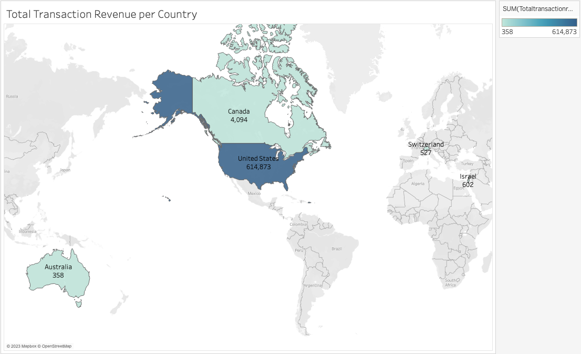

Slide 12
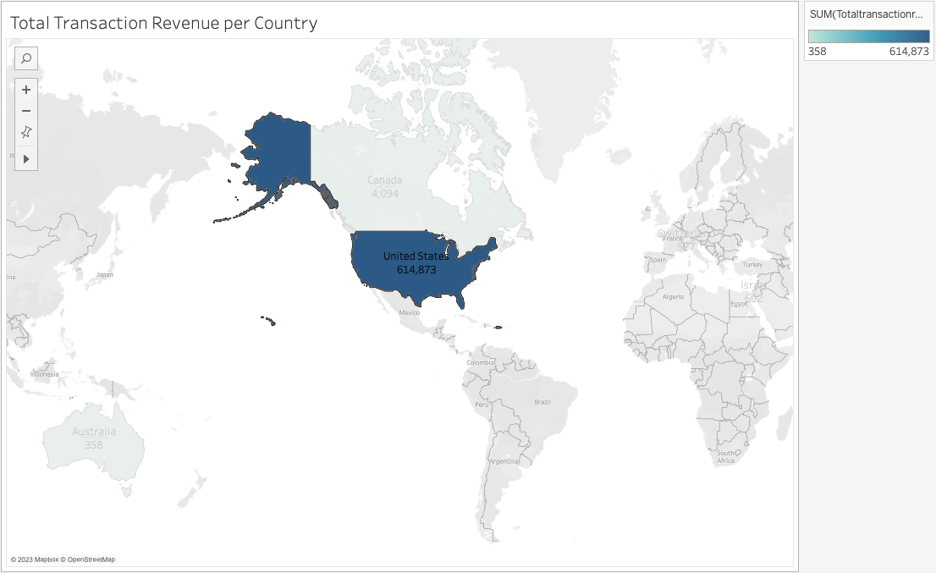

Slide 13
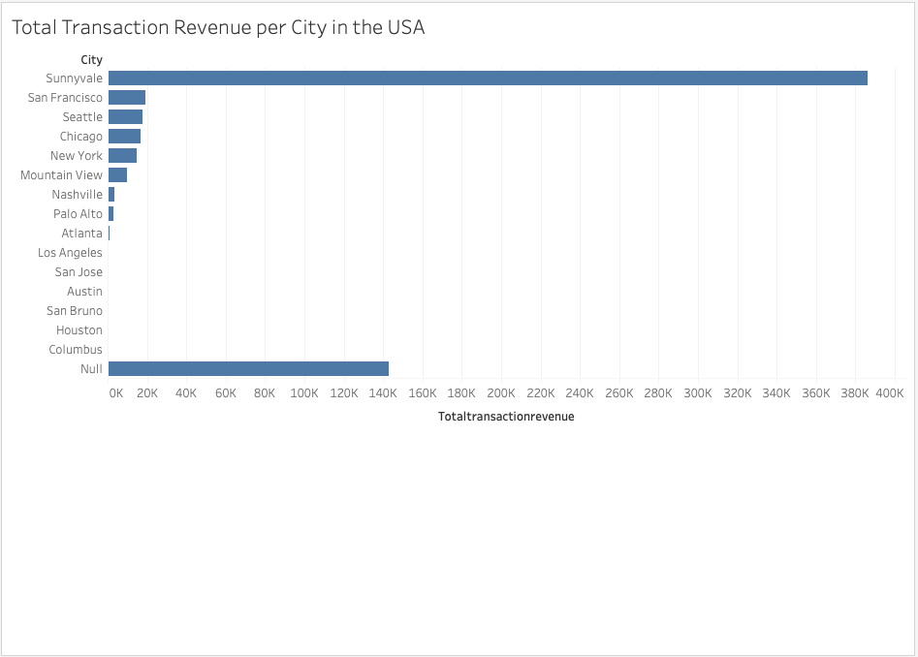

Slide 14
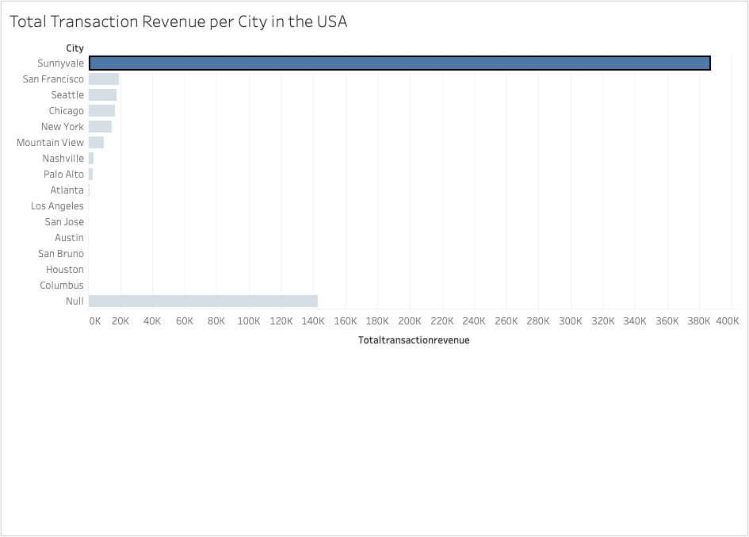

Slide 15
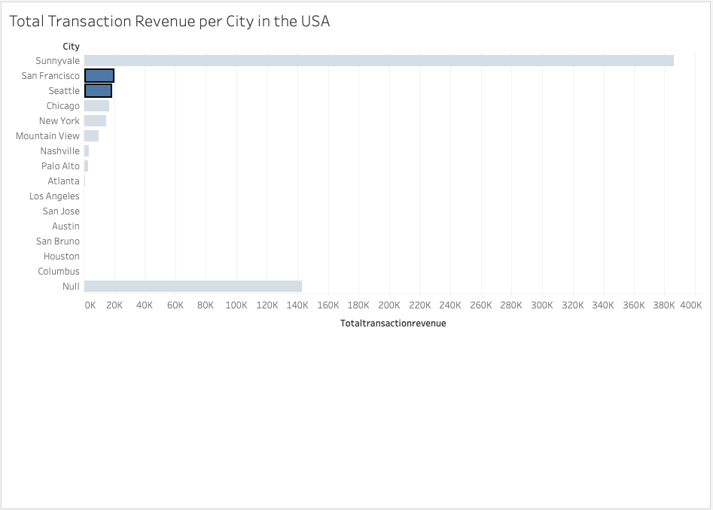

Slide 16
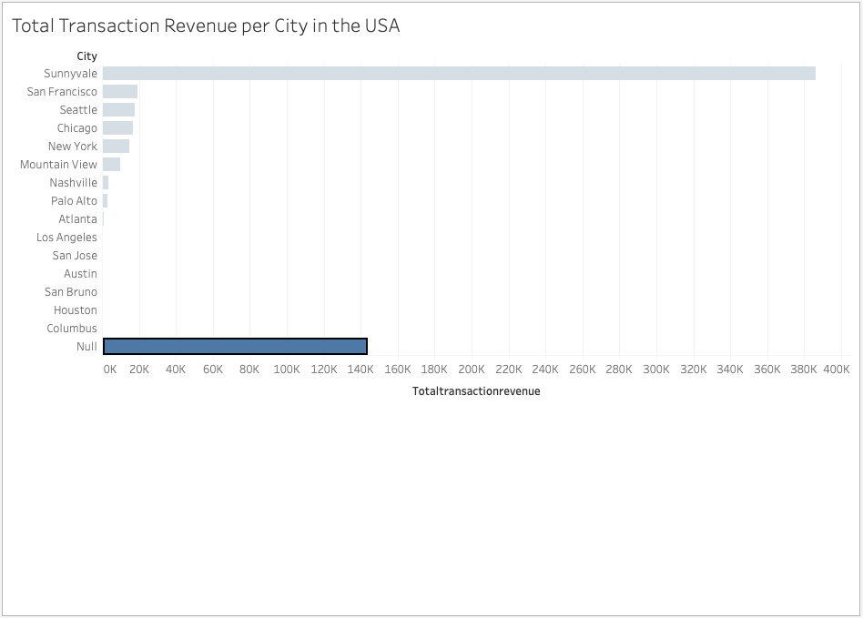

Slide 17
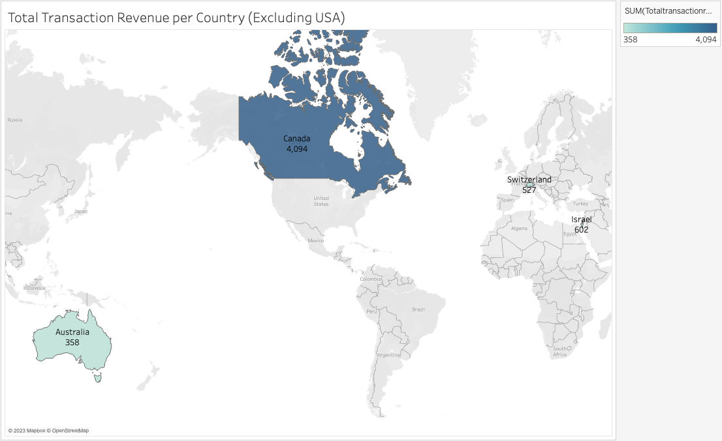

Slide 18
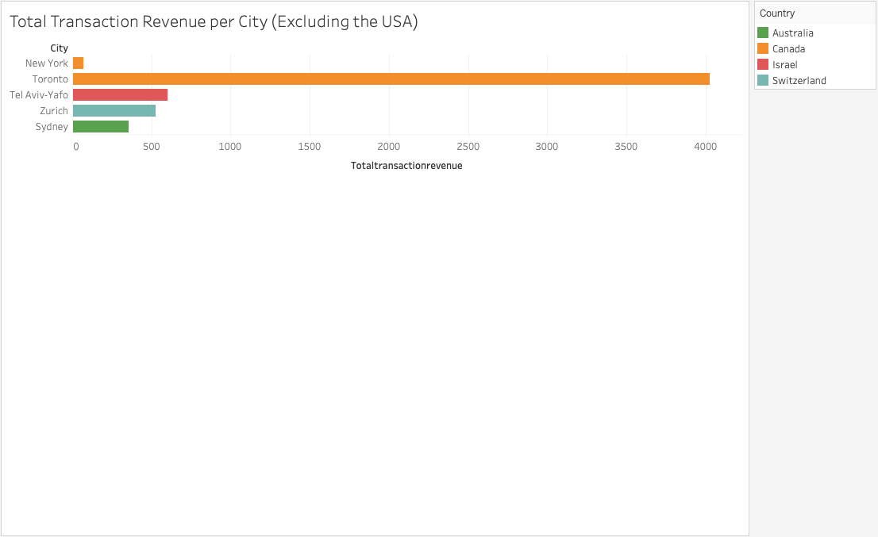

Slide 19
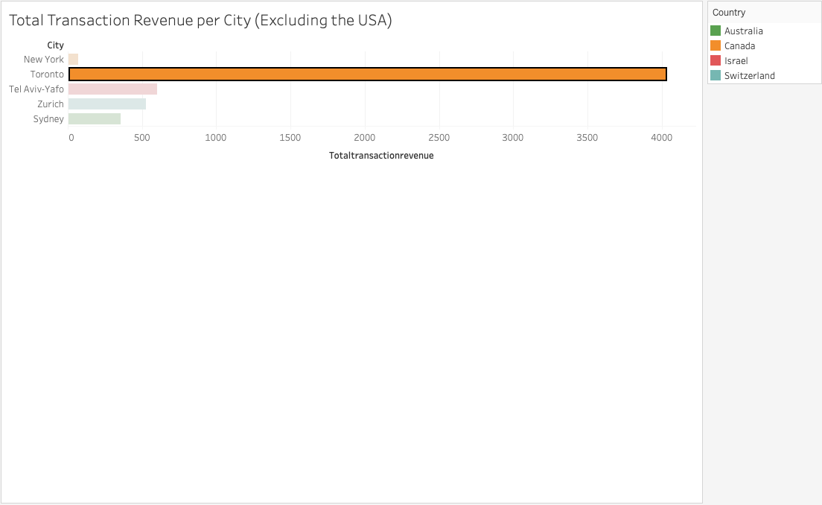

Slide 20
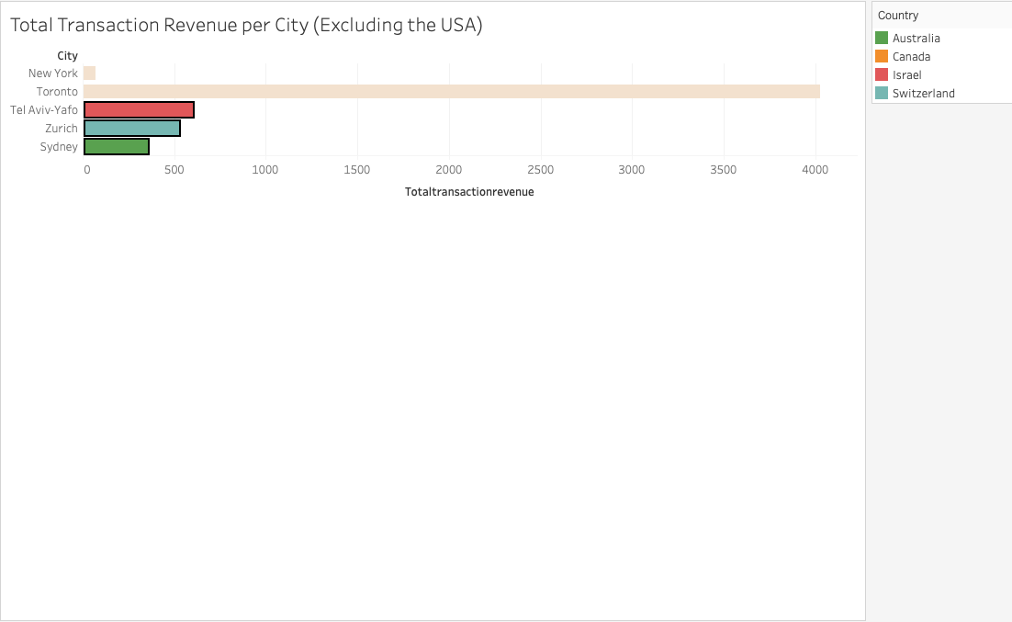

Slide 21
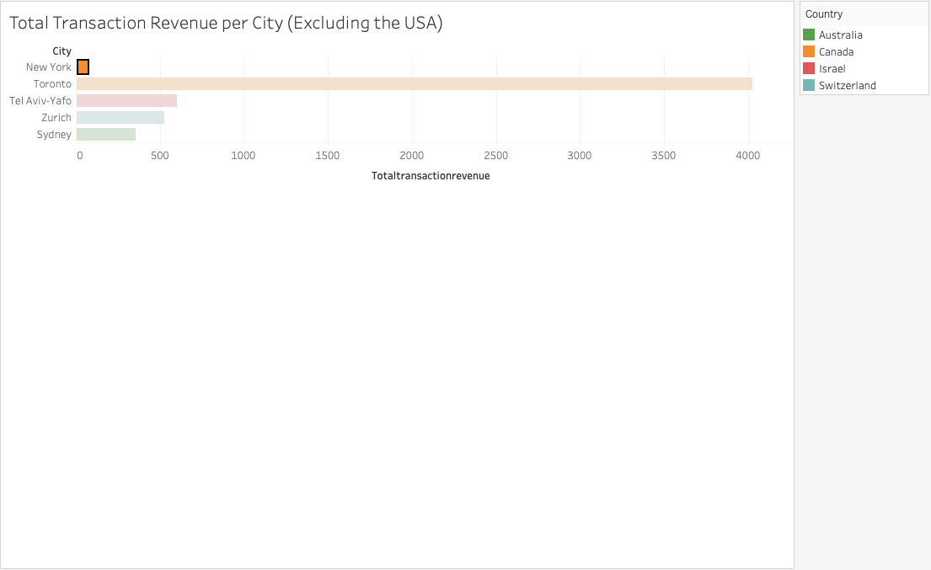

Slide 22
2. What is the average number of products ordered from visitors in each city and country?

Slide 23
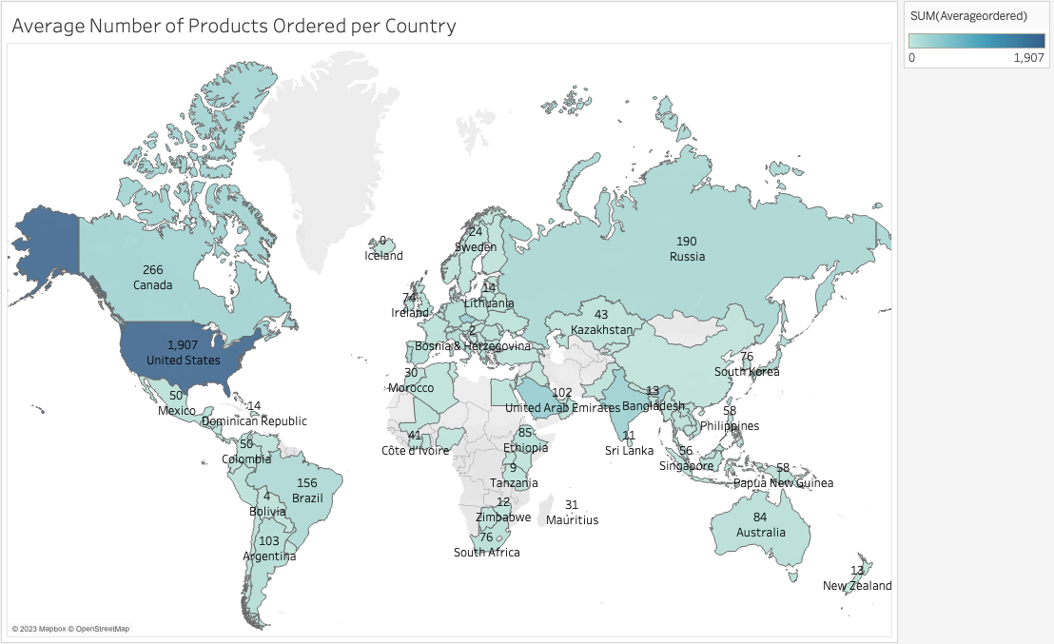

Slide 24
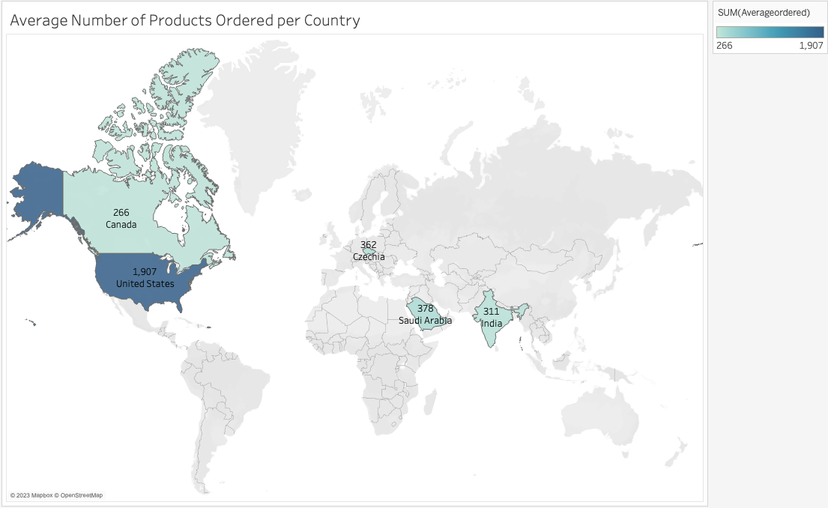

Slide 25
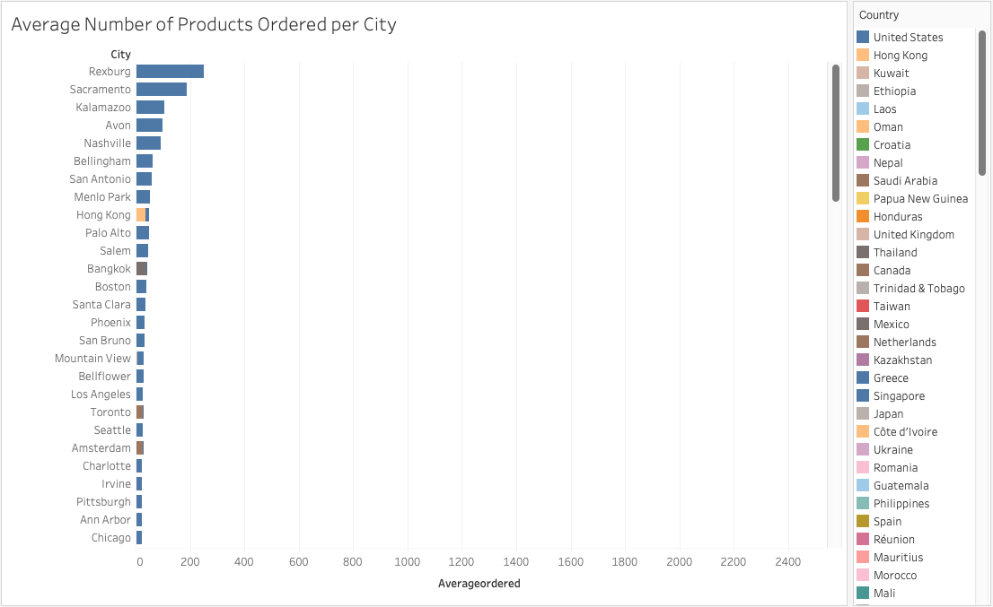

Slide 26
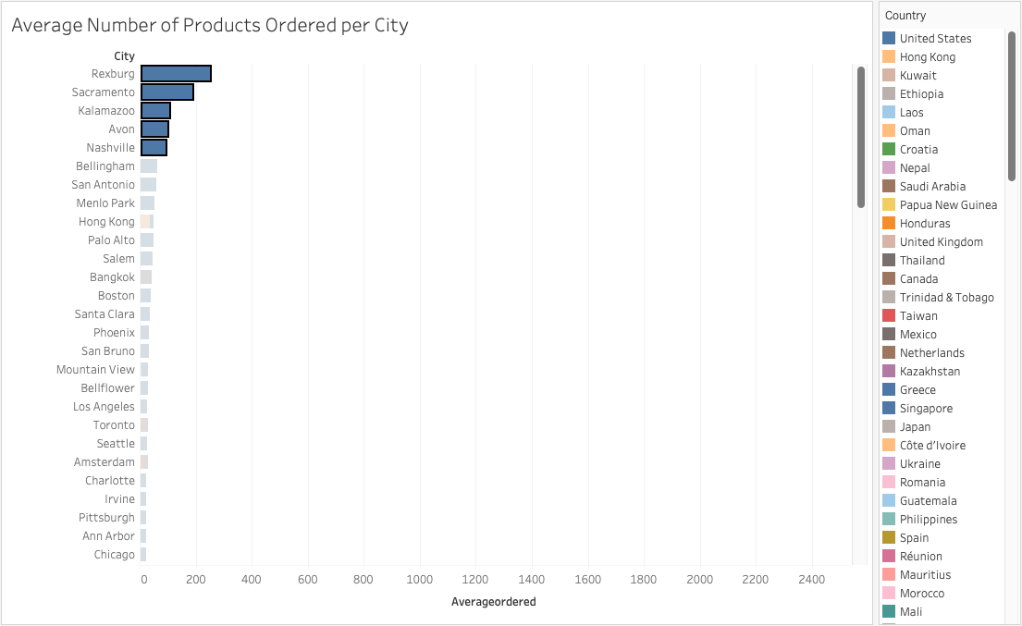

Slide 27
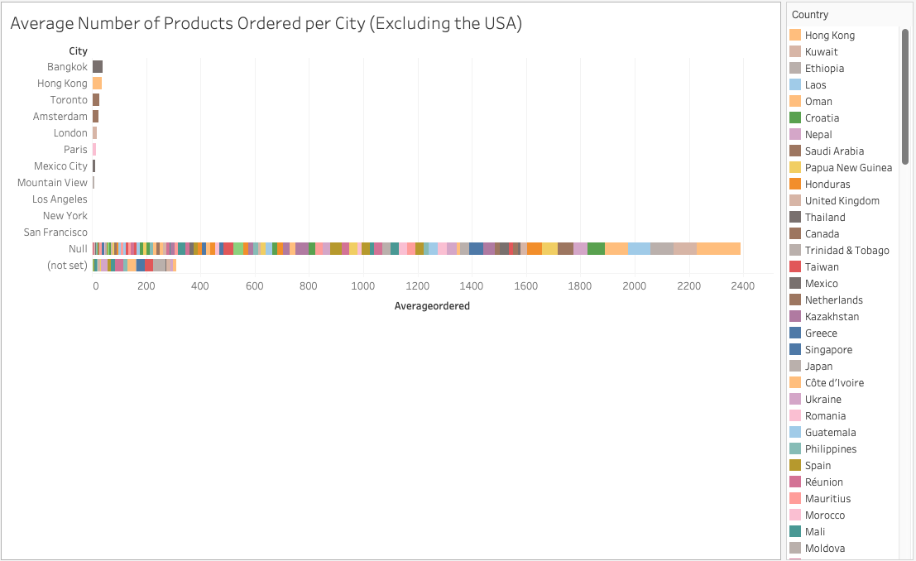

Slide 28
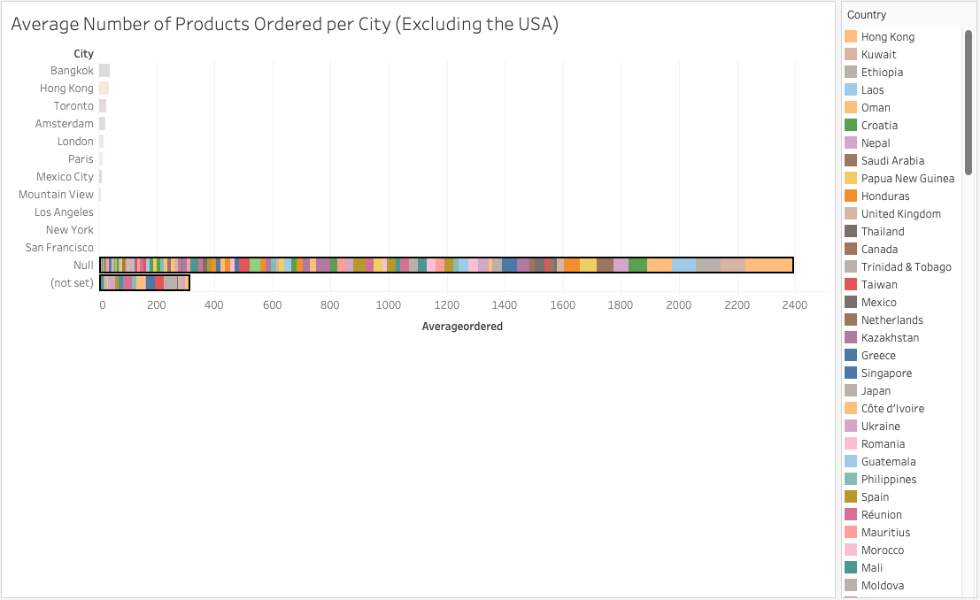

Slide 29
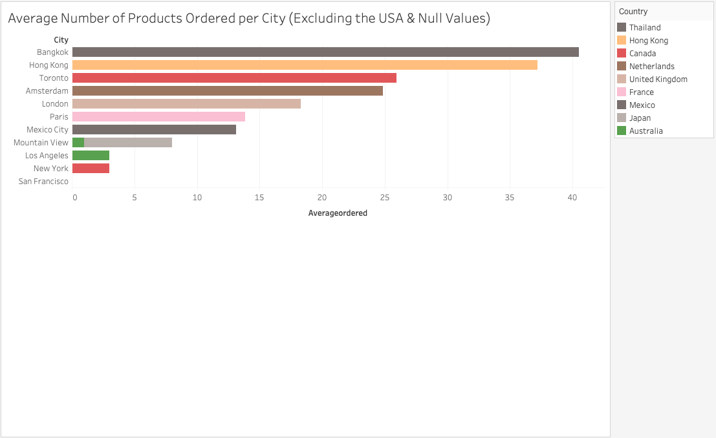

Slide 30
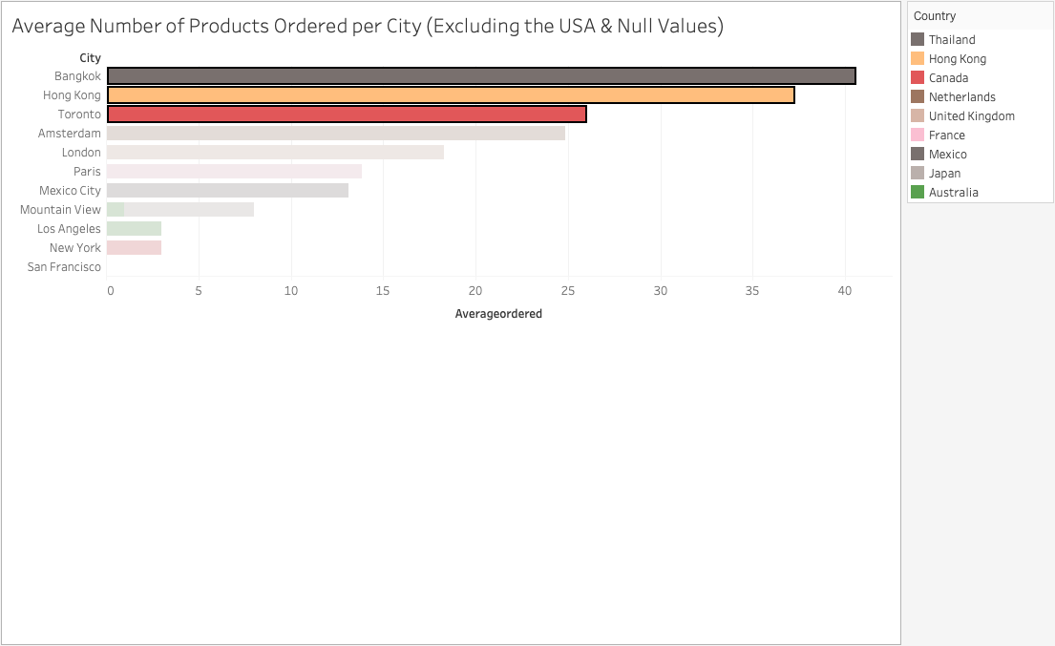

Slide 31
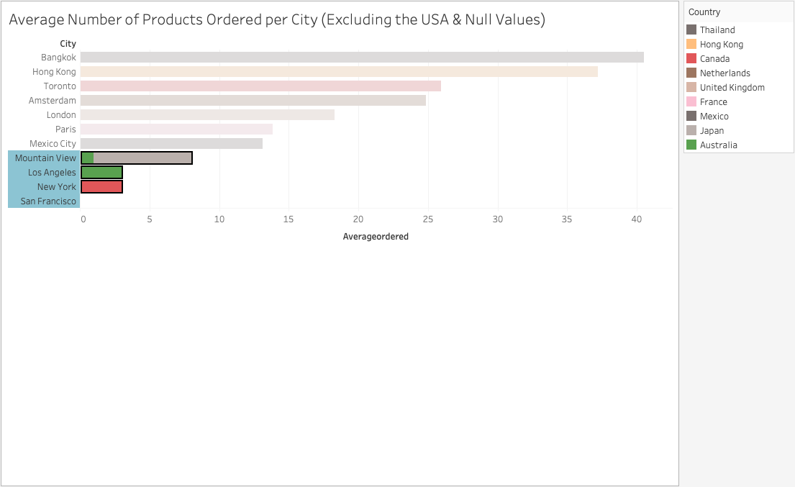

Slide 32
3. Is there any pattern in the types (product categories) of products ordered from visitors in each city and country?

Slide 33
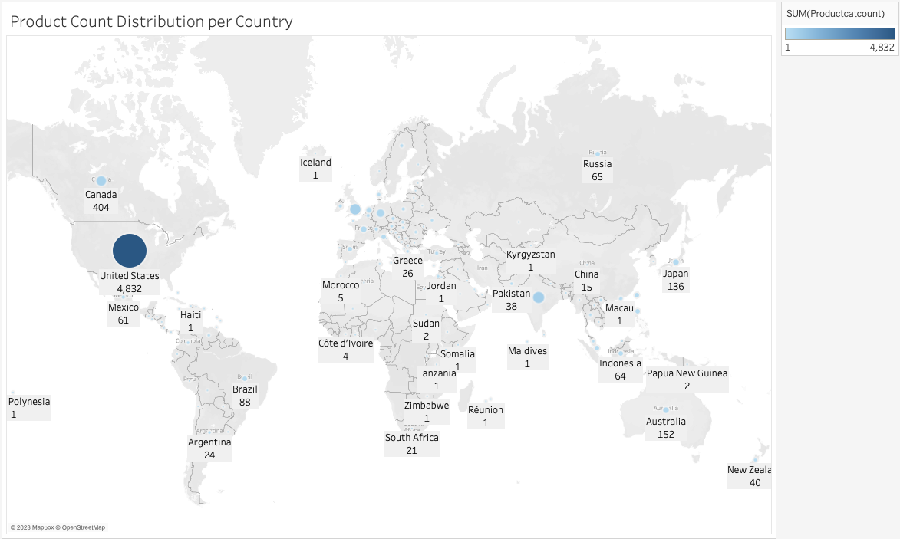

Slide 34
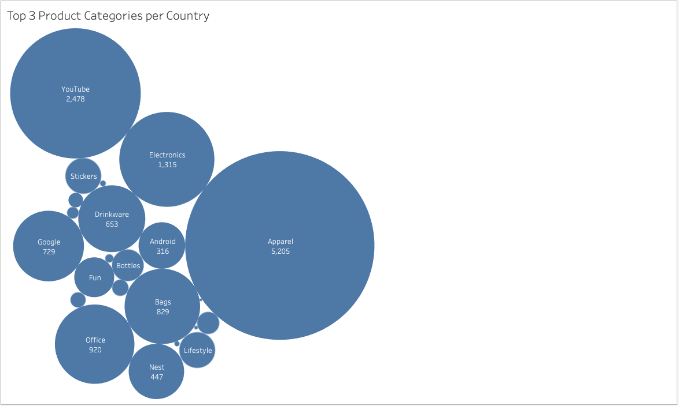

Slide 35
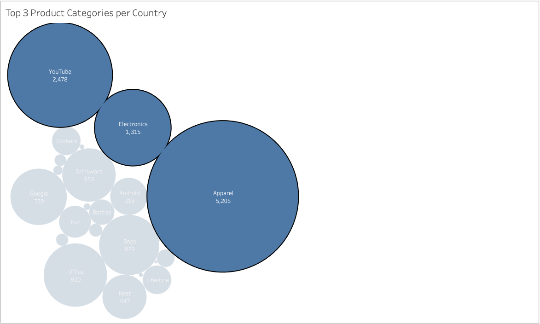

Slide 36
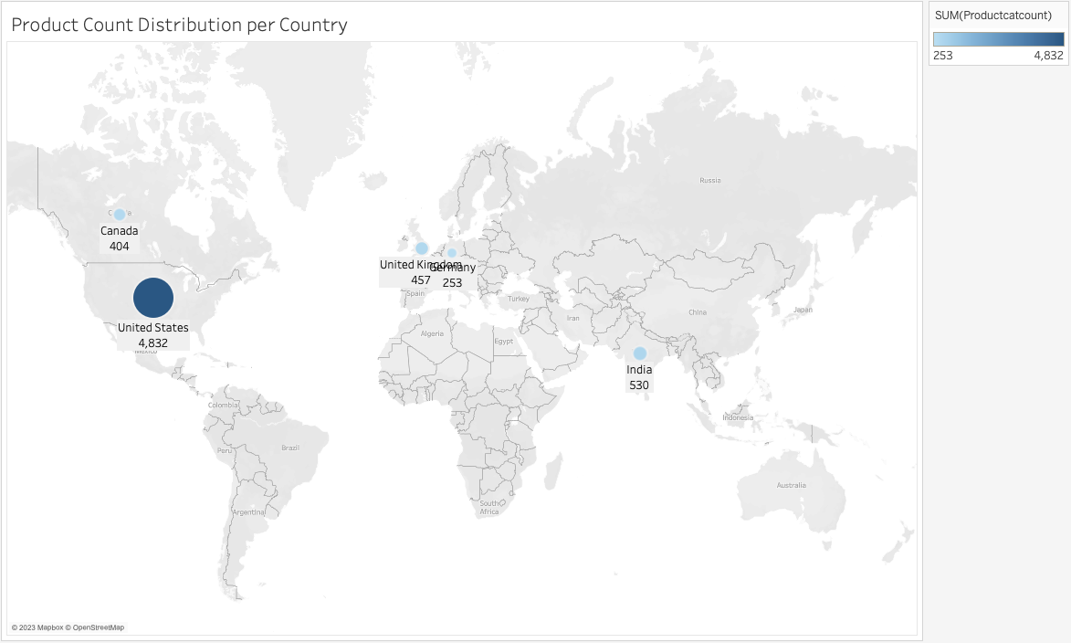

Slide 37
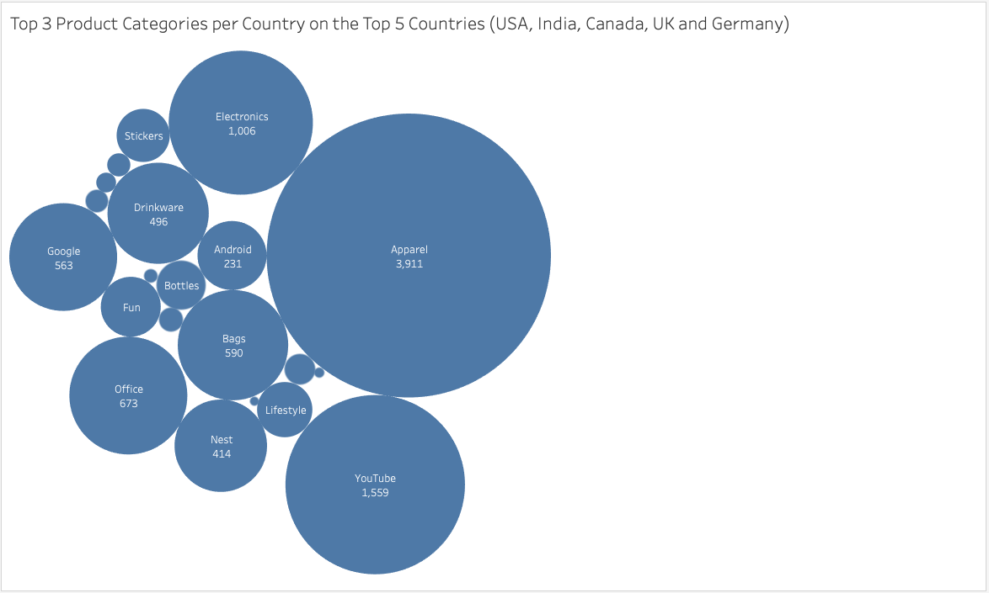

Slide 38
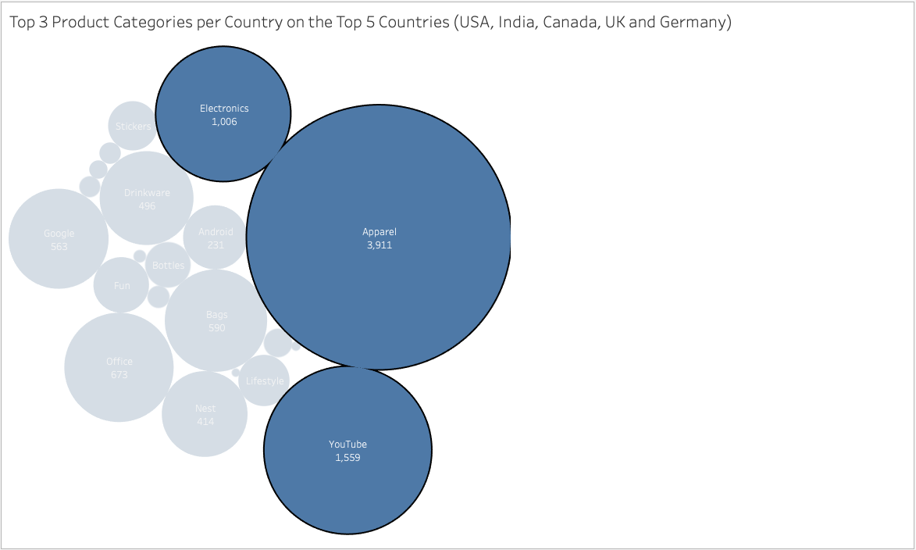

Slide 39
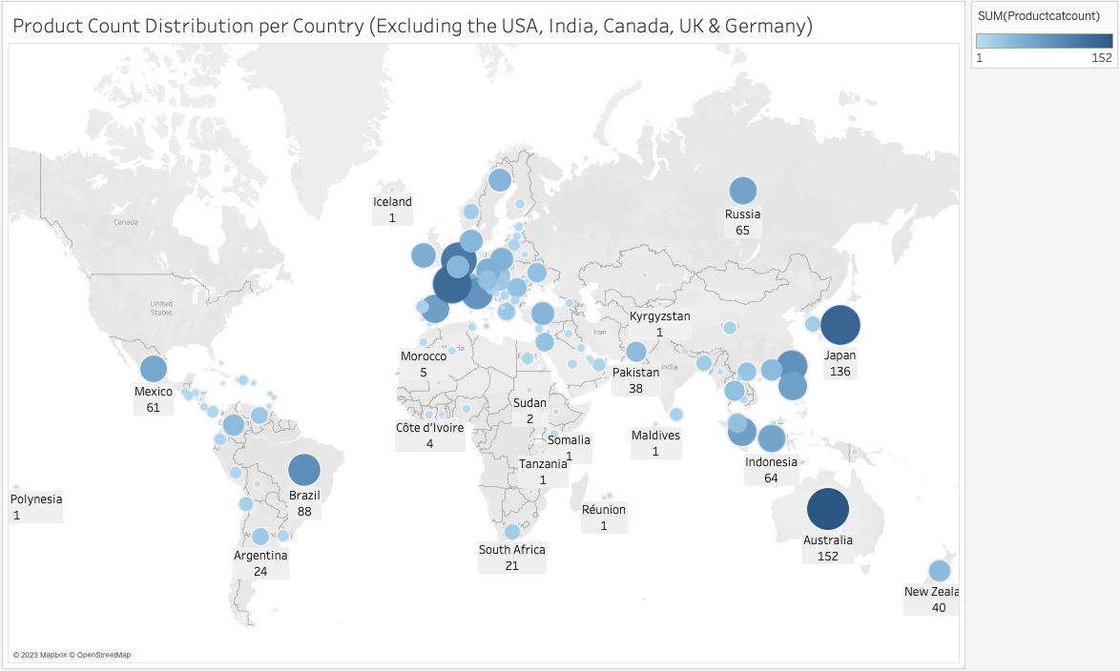

Slide 40
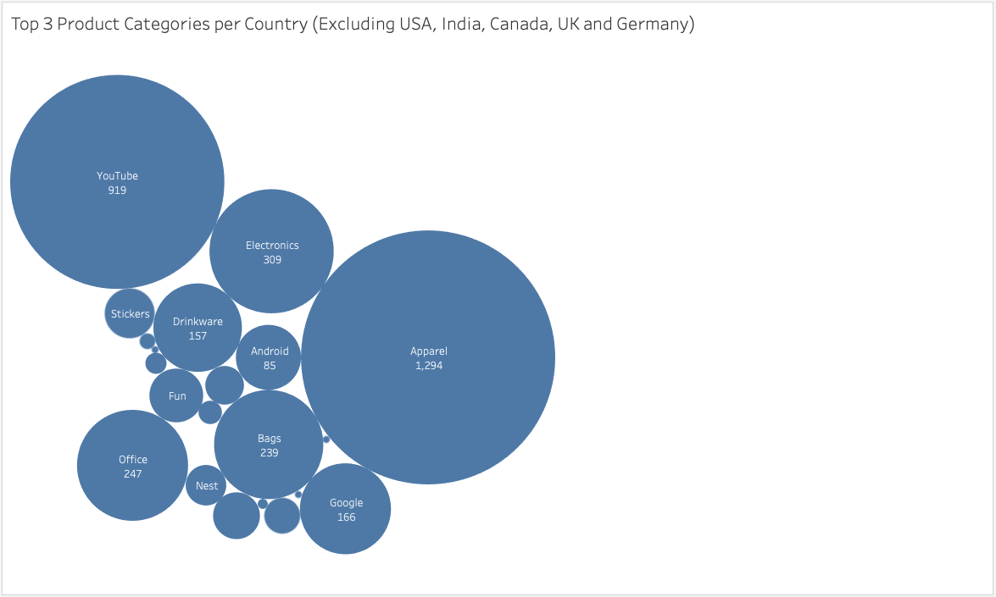

Slide 41
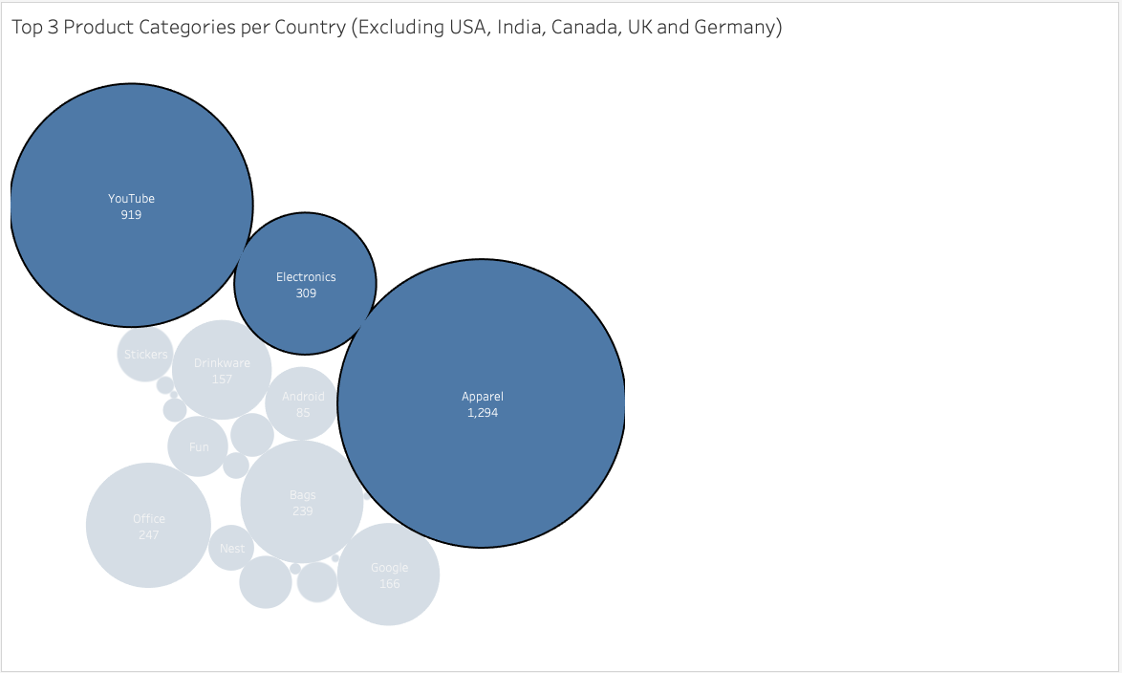

Slide 42
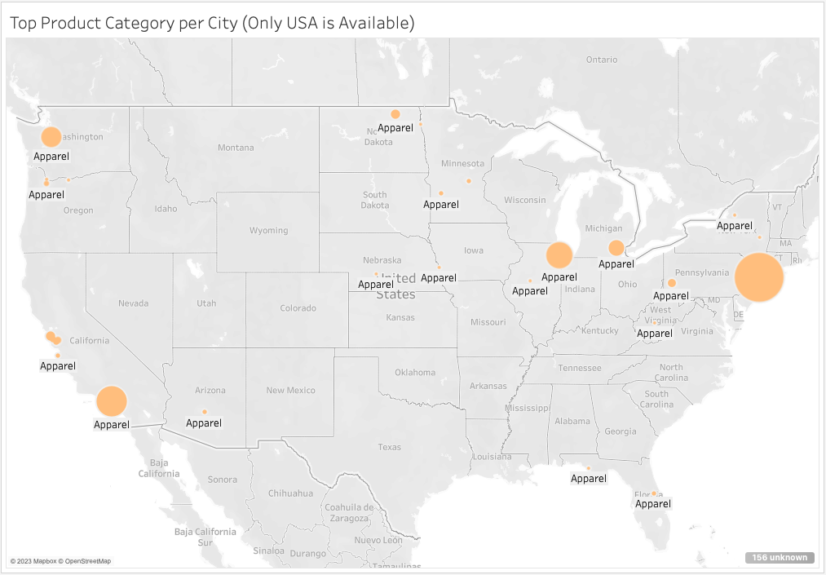

Slide 43
4. What is the top-selling product from each city/country? Can we find any pattern worthy of noting in the products sold?

Slide 44
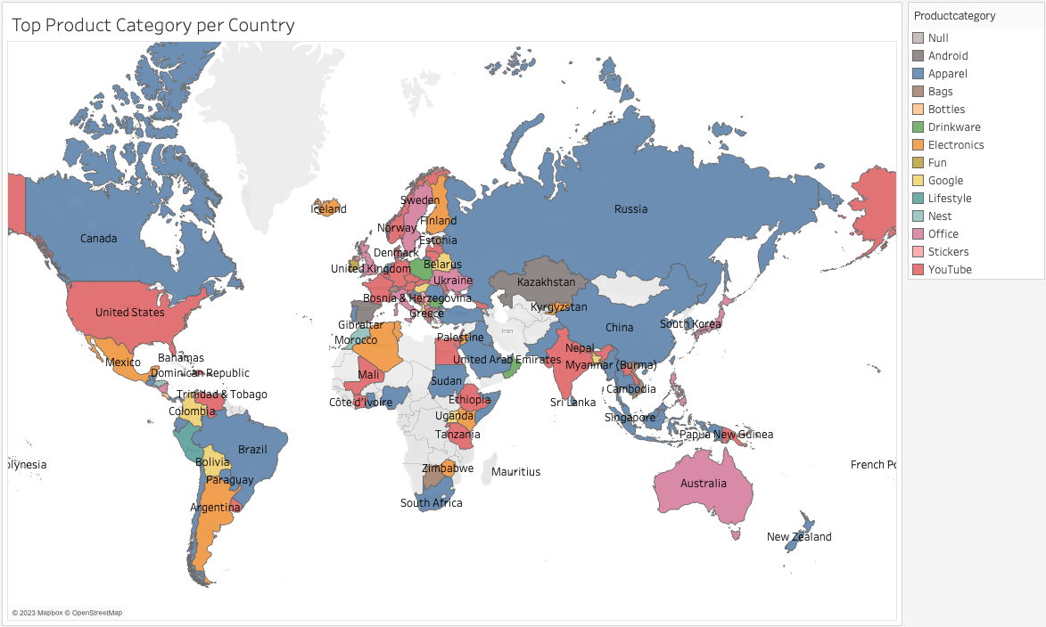

Slide 45
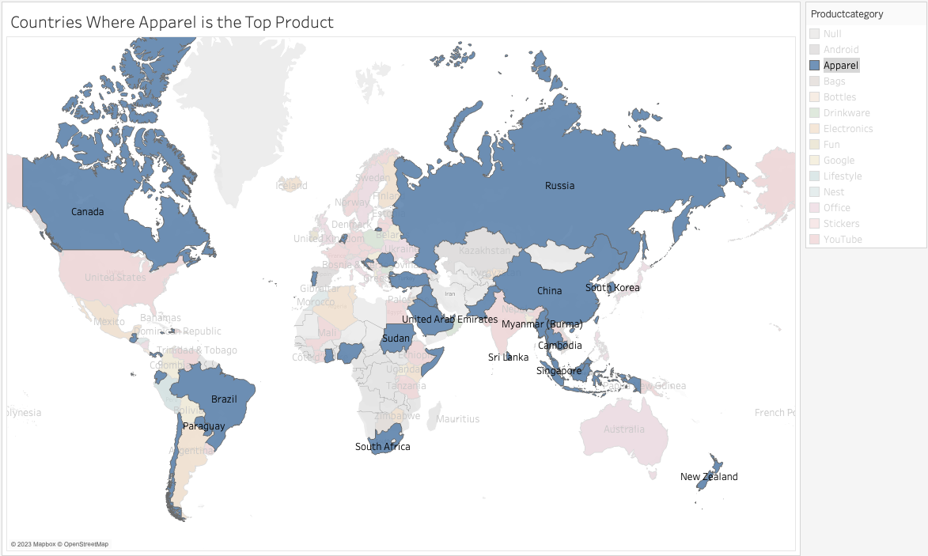

Slide 46
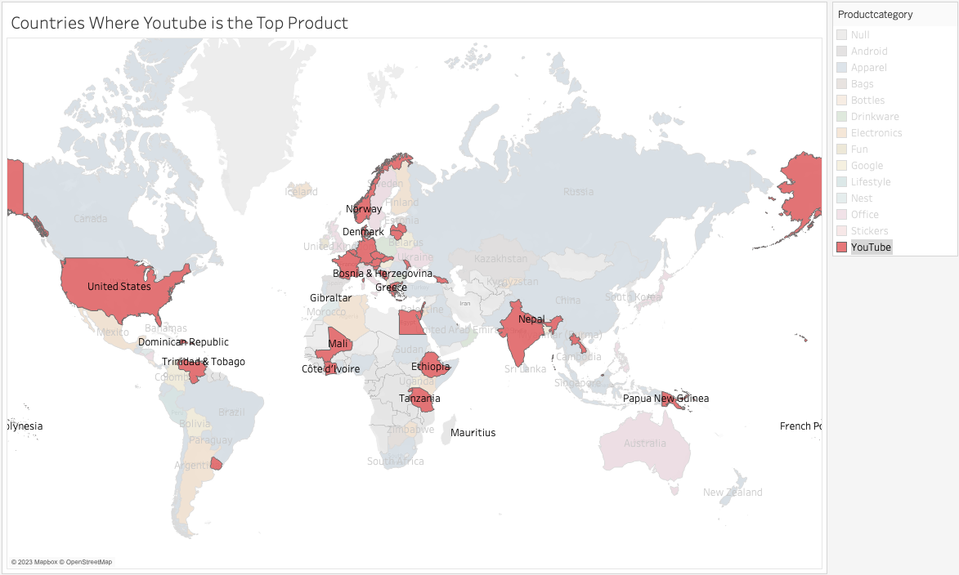

Slide 47
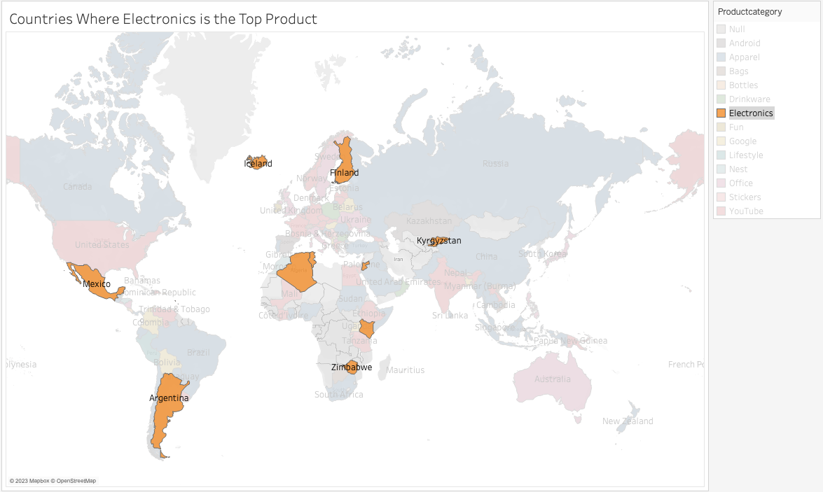

Slide 48
5. Can we summarize the impact of revenue generated from each city/country?

Slide 49
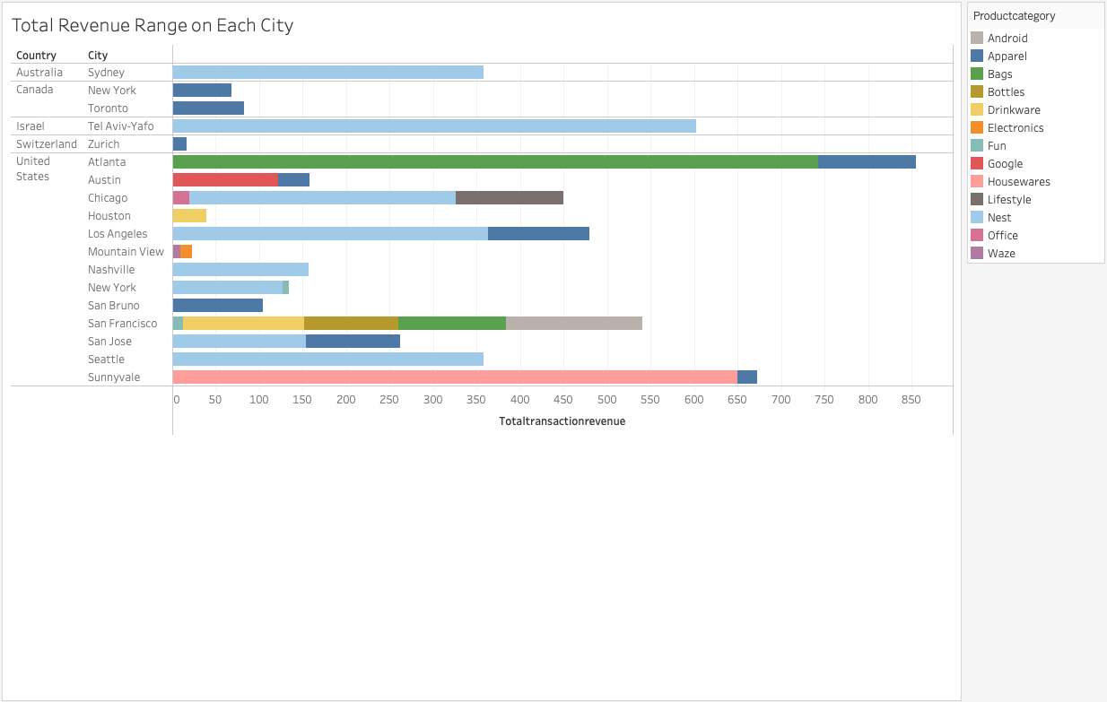

Slide 50
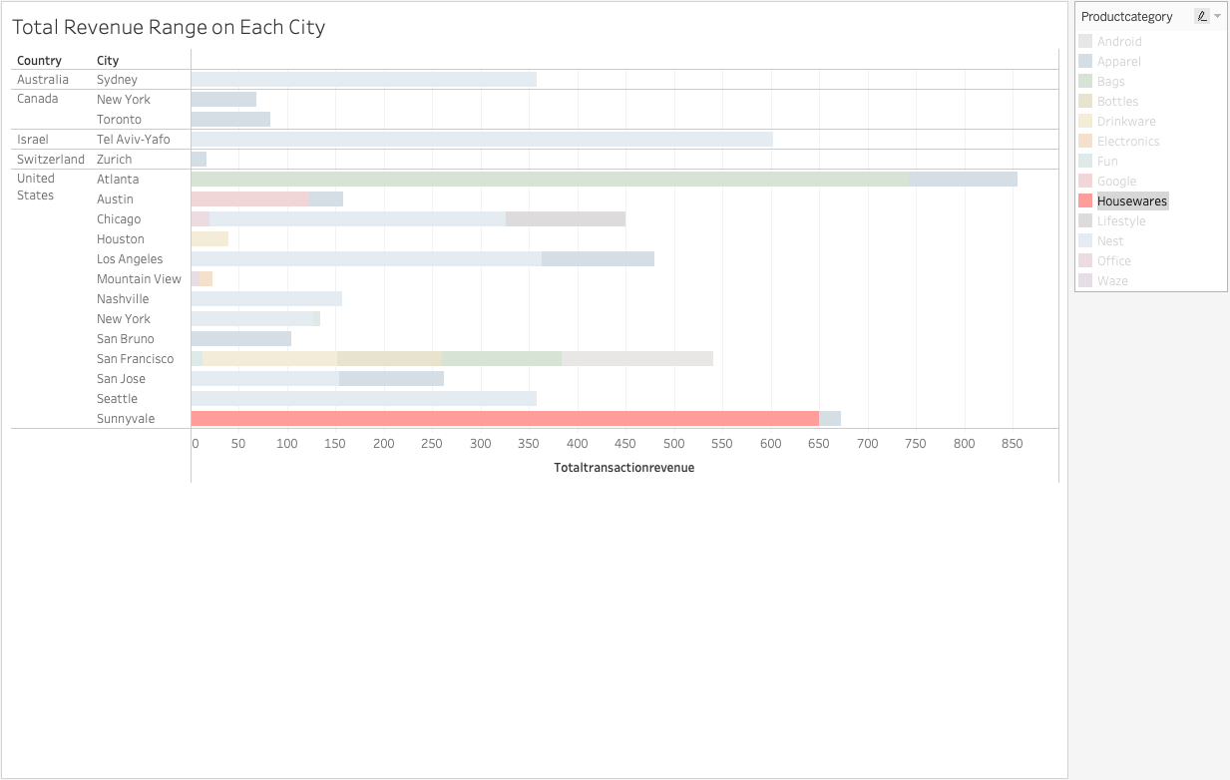

Slide 51
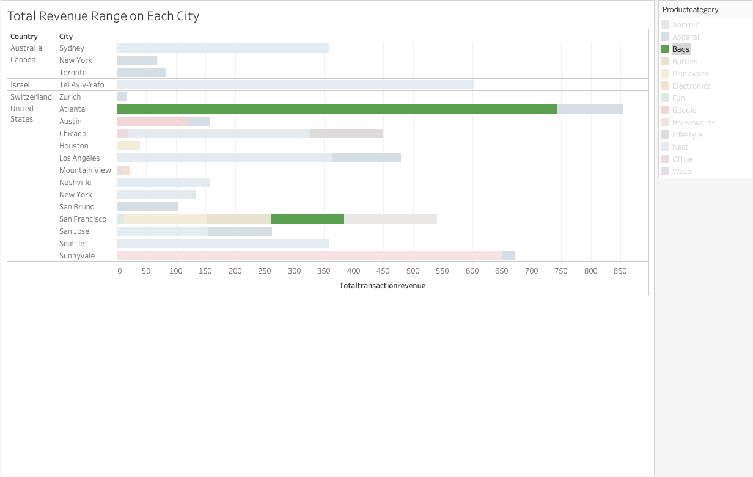

Slide 52
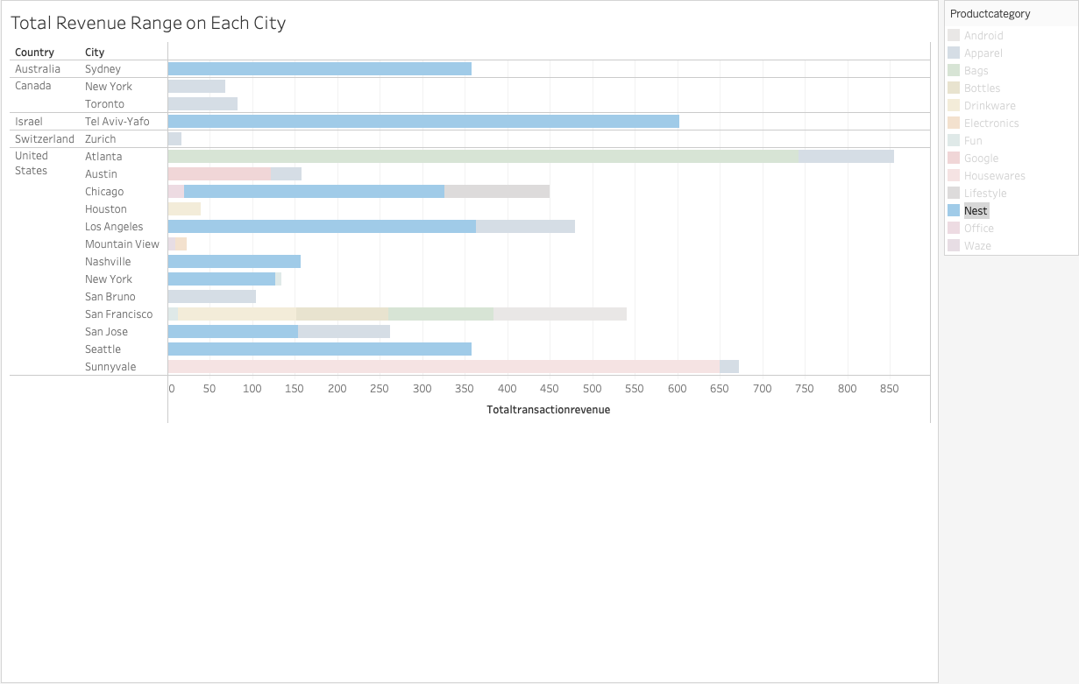

Slide 53
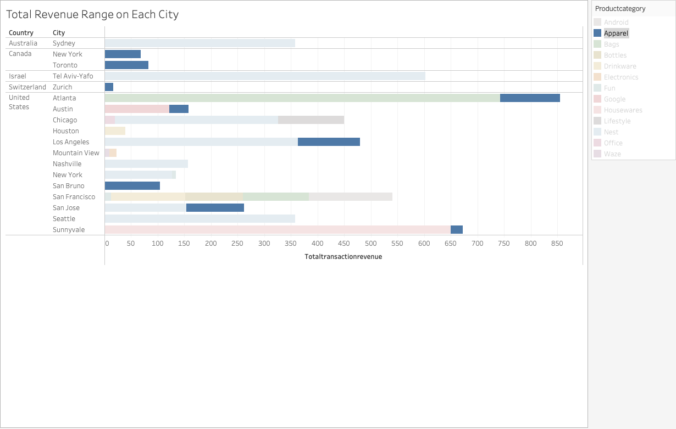

Slide 54
If I had more time

Slide 55
Recommendations
Proceed to the next data cleaning stage and data exploratory analysis; and
Conduct Natural Language Analysis on each of the top product category to determine the best product recommendations for each city/country.
Recommendation System

